Slide 1
Recap of work so far
Kinetic-molecular theory of gases
Why gases cool on expansion, heat up on compression
-> How much energy is in a sample of gas molecules? (Week 3)
Thermodynamic surfaces

Slide 2
Recap: Kinetic-molecular theory of gases
Normally, when a molecule hits a wall, it bounces back with the same speed.
Mental representation of a gas: molecules in constant motion

Slide 3
Recap: Kinetic-molecular theory of gases
Normally, when a molecules hits a wall, it bounces back with the same speed.
But when it hits a receding wall, it bounces back more slowly.
Slower-moving molecules correspond to lower temperature.
Mental representation of a gas: molecules in constant motion

Slide 4
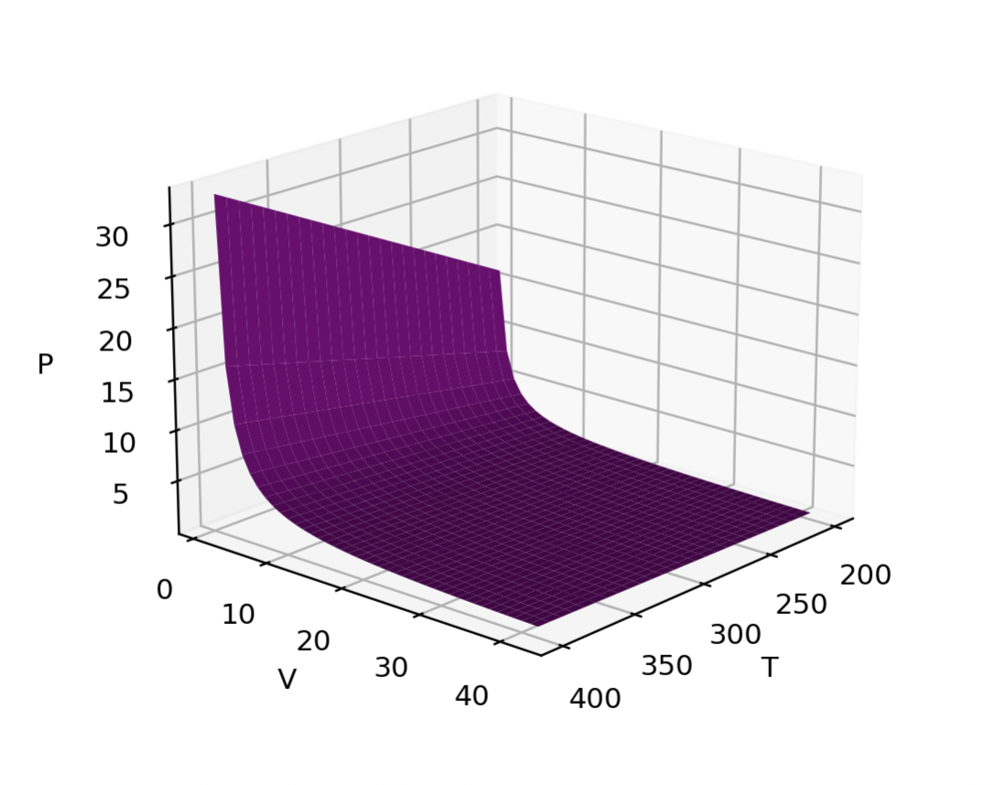
Here, the state function is the pressure of a gas.
The state space consists of the gas’s temperature and volume.
Each combination of temperature and pressure implies a particular value of the pressure:
P(T,V)
This one is an ideal gas, actually. So we can say
P(T,V)=nRT/V
Here we’re also showing a constant-temperature slice through P(T,V), also called an isotherm of P.
Recap: Thermodynamic surfaces

Slide 5
Today
Ideal Gas Law
van der Waals (vdw) gas law
Entering numbers in scientific notation: the E-format
Units: using pint’s AssignQuantity
Evaluating the difference between an ideal gas and a vdw gas

Slide 6
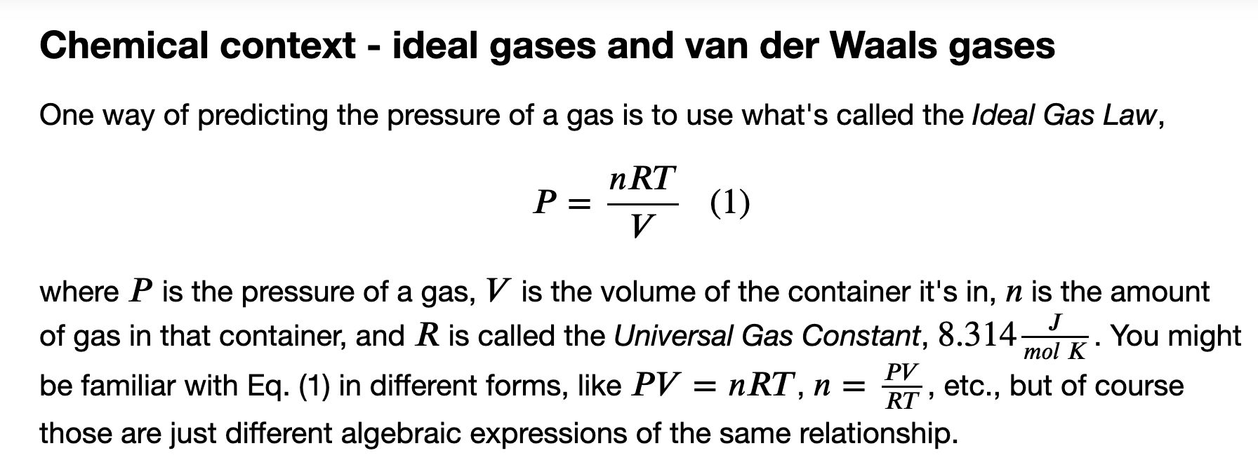
The Ideal Gas Law

Slide 7

Some reasons we would expect a real gas to have higher or lower pressure than an ideal gas
Intermolecular forces
Attractions => $P_{real}<P_{ideal}$
Repulsions => $P_{real}>P_{ideal}$

Slide 8
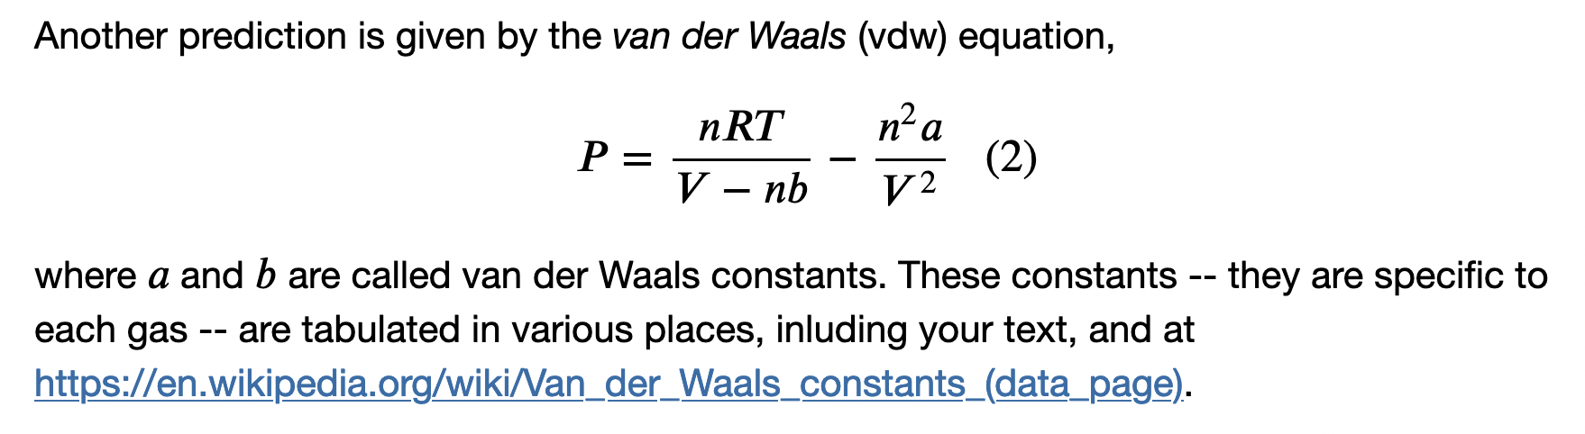
The van der Waals Gas Law
Since a and b are tuned to each gas, we expect Eq. (2) to be more accurate than the ideal gas law. Spoiler: deviations are biggest when the volume is small.
When “a” is big, intermolecular attractions are significant, and the pressure is smaller than ideal.
When “b” is big, intermolecular repulsions are significant, and the pressure is bigger than ideal.

Slide 9
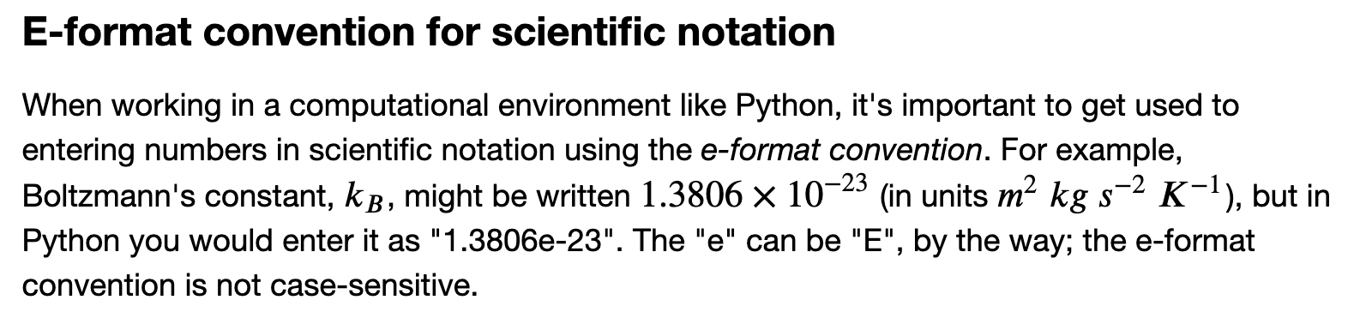
Scientific notation

Slide 10
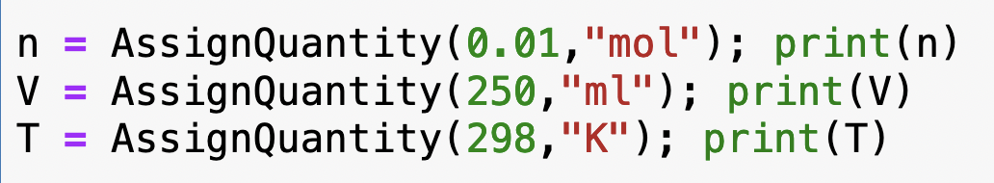
Units: using pint
This is how you bring pint into your Python notebook (“importing”)
Super-handy because AssignQuantity attaches units for you:

Slide 11
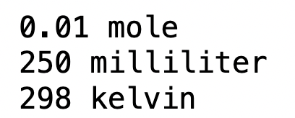
Units: using pint
This is how you bring pint into your Python notebook (“importing”)
Super-handy because AssignQuantity attaches units for you:

Slide 12
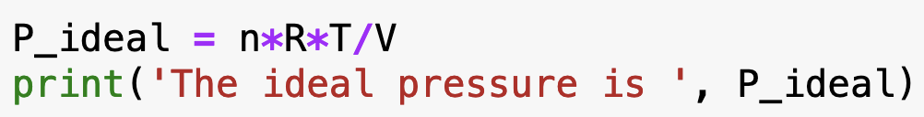
Units: using pint
Why is that cool? Because variables that have units are carried through when you do a calculation! Say you want to approximate a real gas by the ideal gas law. In Python, you could say

Slide 13
Units: using pint
Why is that cool? Because variables that have units are carried through when you do a calculation! Say you want to approximate a real gas by the ideal gas law. In Python, you could say

Slide 14
Units: using pint
Why is that cool? Because variables that have units are carried through when you do a calculation! Say you want to approximate a real gas by the ideal gas law. In Python, you could say
But joule / milliliter is not a unit of pressure that anybody uses! So we need to convert it …

Slide 15
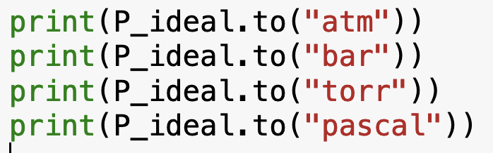
Units: using pint
pint does conversions for you too!

Slide 16
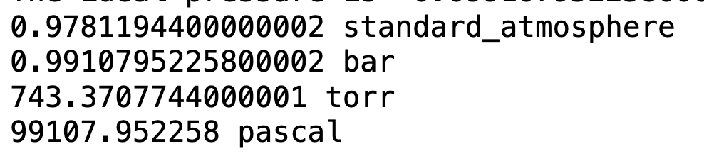
Units: using pint
Pint does conversions for you too!

Slide 17
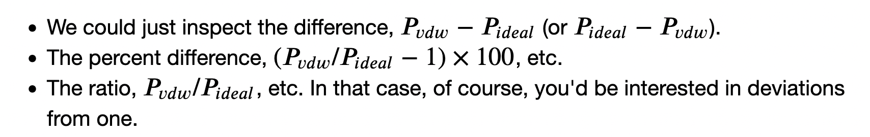
Evaluating the difference between an ideal gas and a vdw gas
Call this P_ideal in your Jupyter Notebook
Call this P_vdw in your Jupyter Notebook

